Slide 1
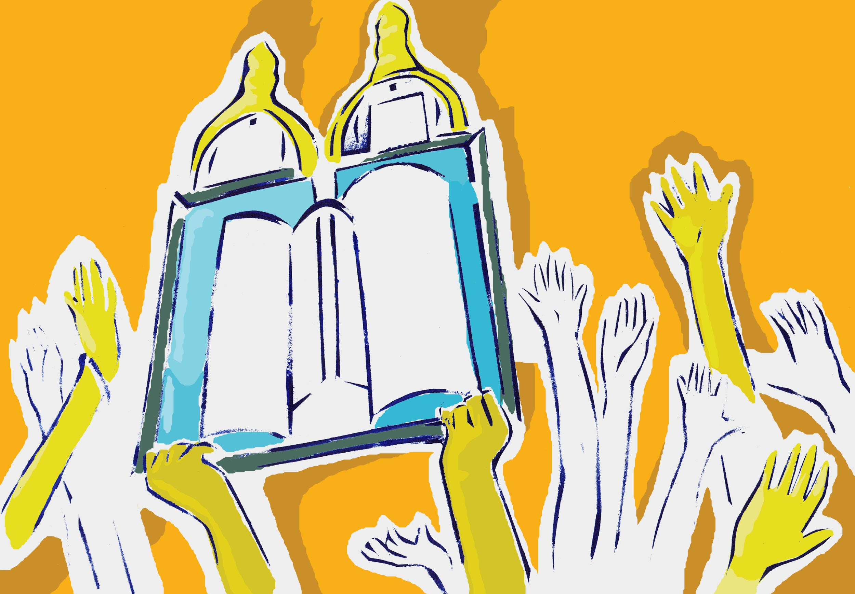
What is Simchat Torah?
A social story
by
www.jkidaccess.org

Slide 2
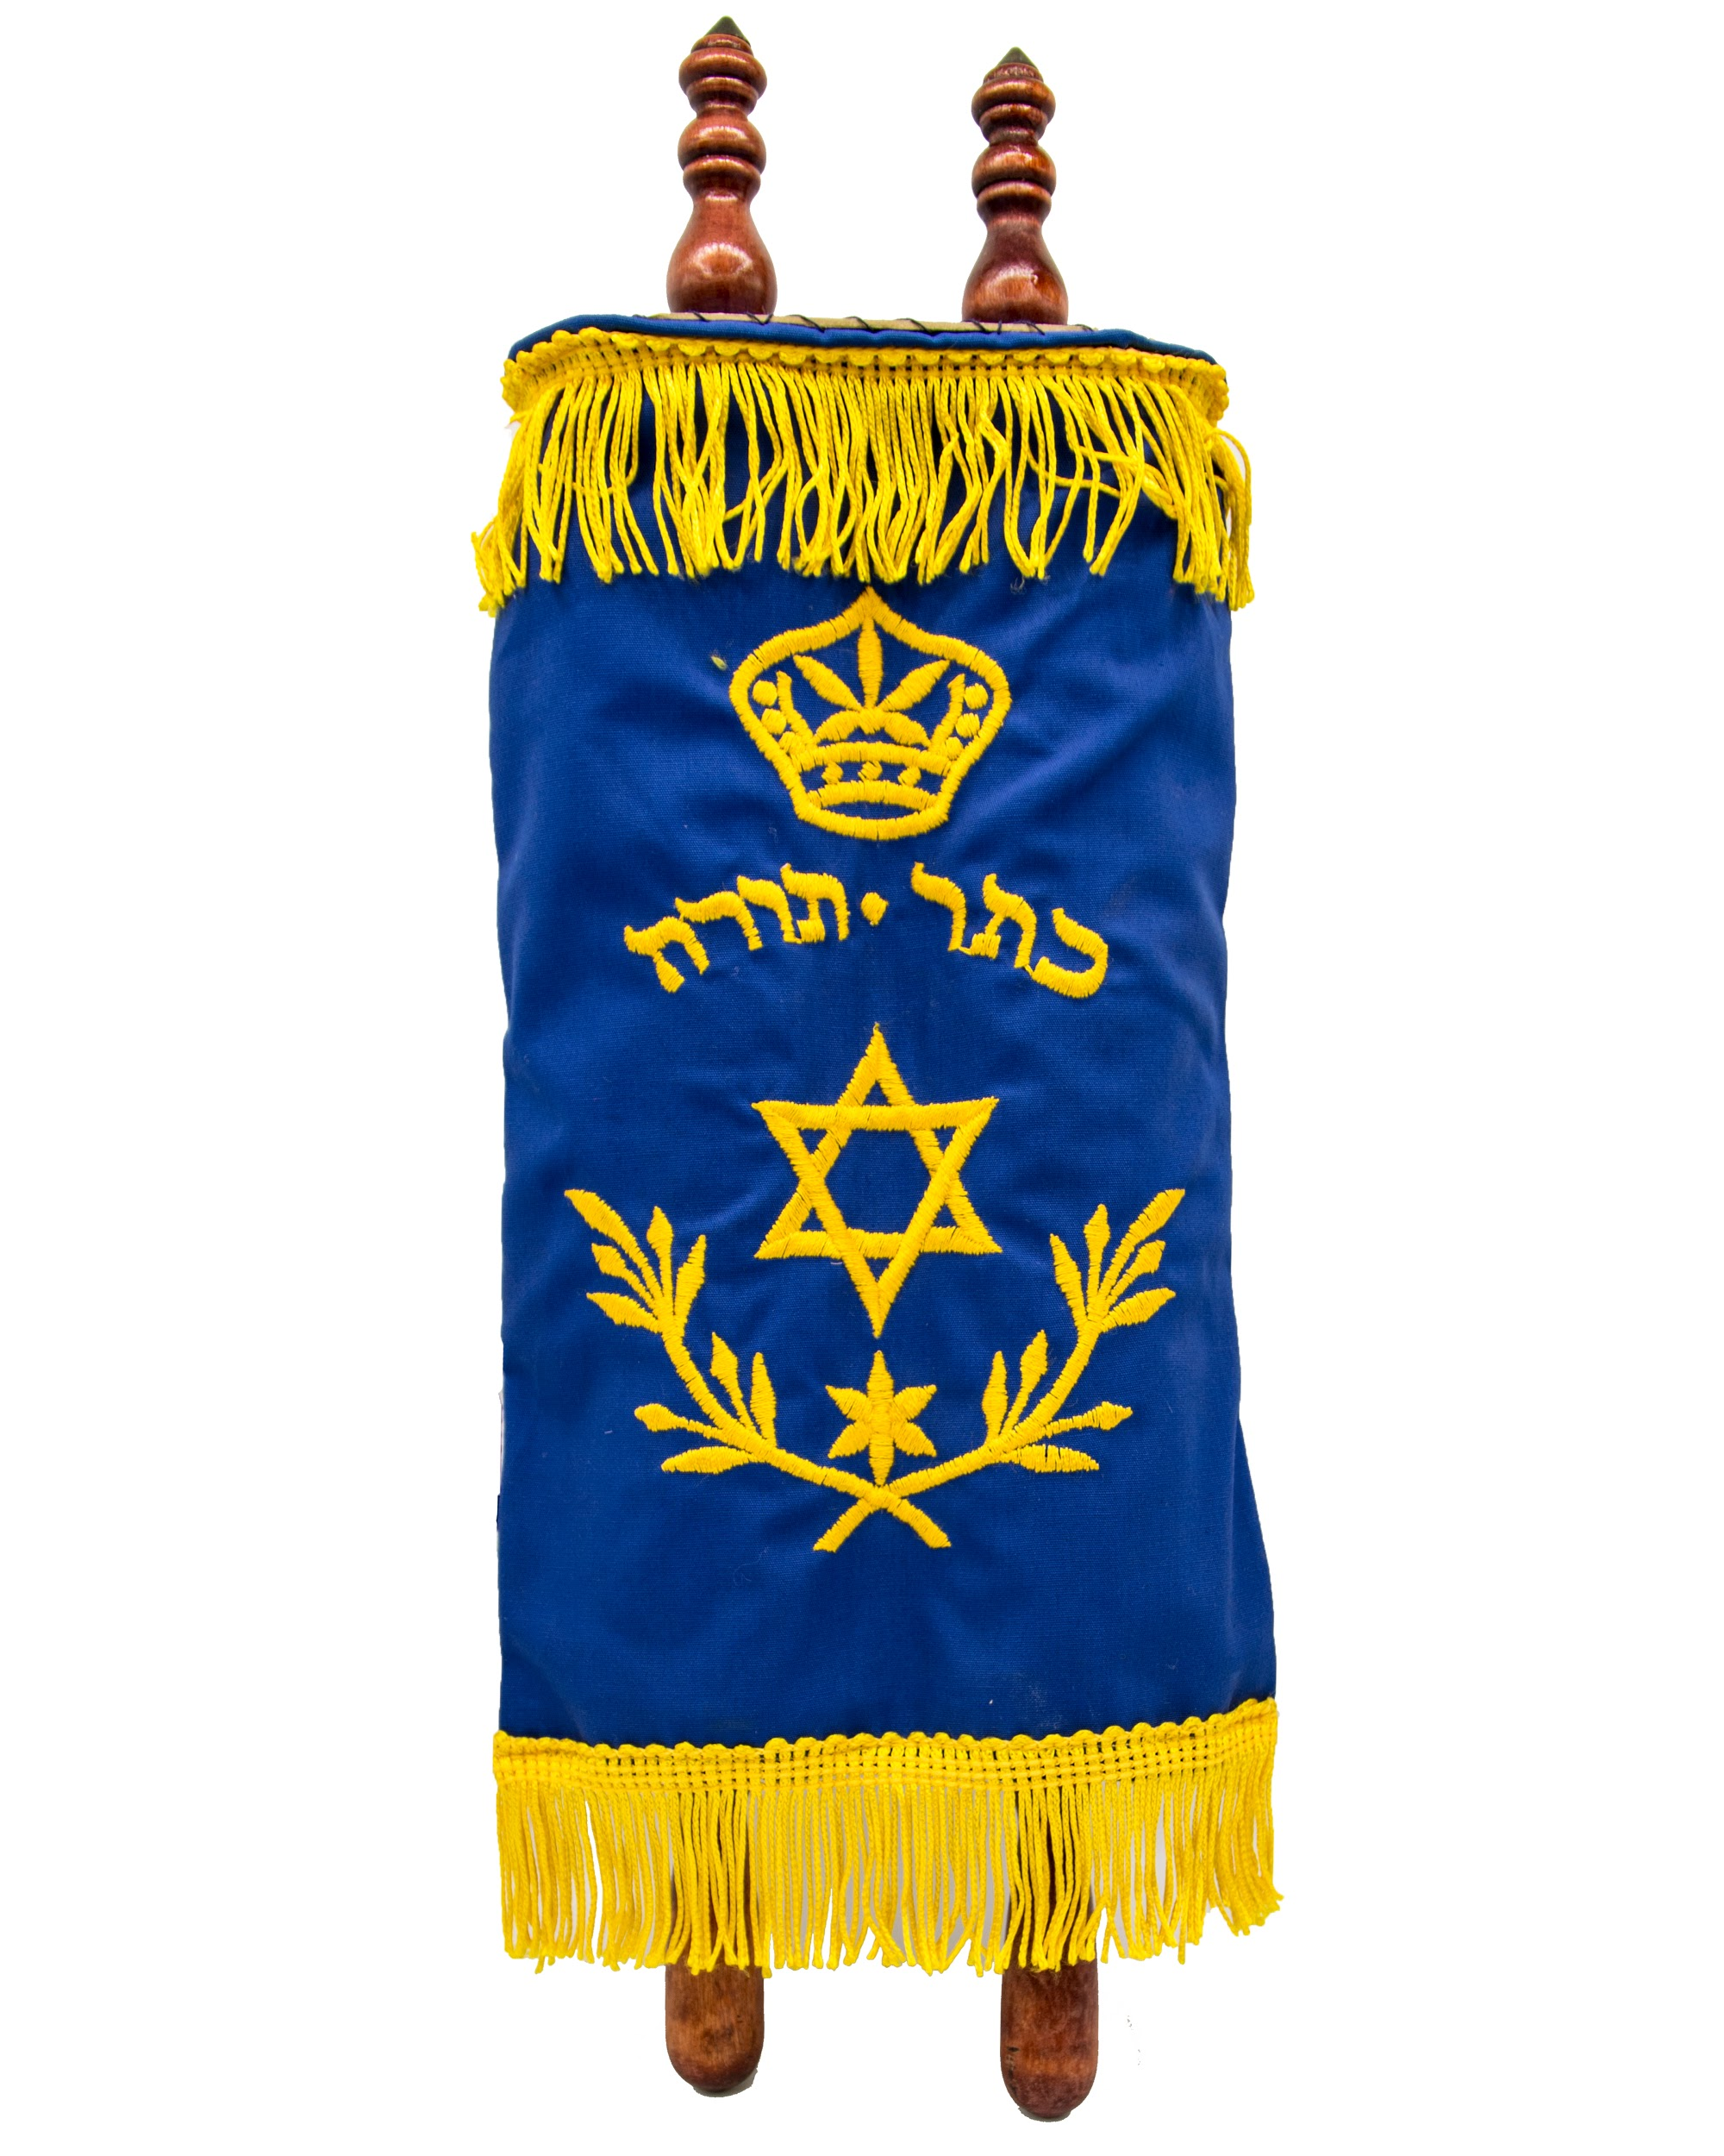
2
On Simchat Torah we celebrate the time when we finish reading an entire Torah scroll.
www.jkidaccess.org

Slide 3
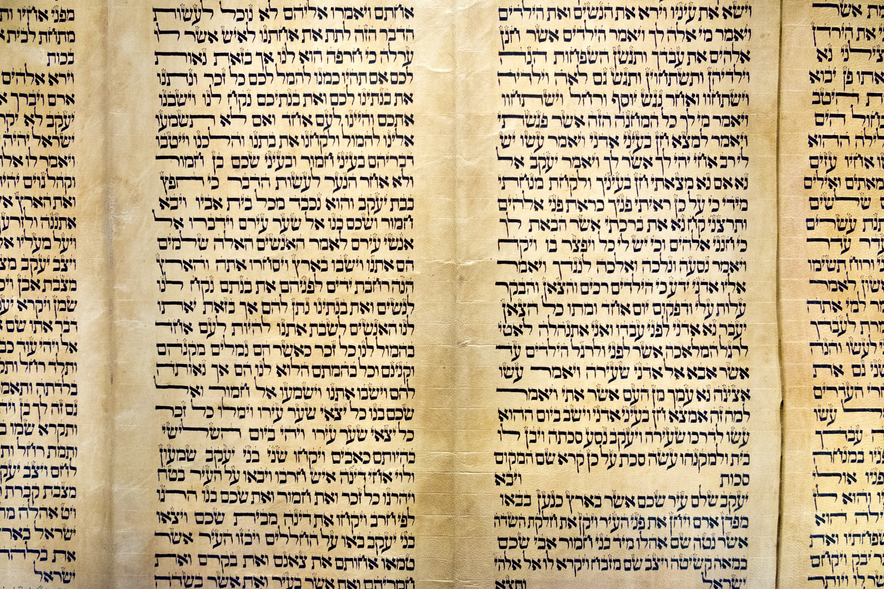
3
Have you seen the inside of a Torah? It contains lots of Hebrew words that tell important stories.
www.jkidaccess.org

Slide 4
4
The Torah is very important to Jewish people. The stories tell us how to be kind and helpful.
www.jkidaccess.org

Slide 5
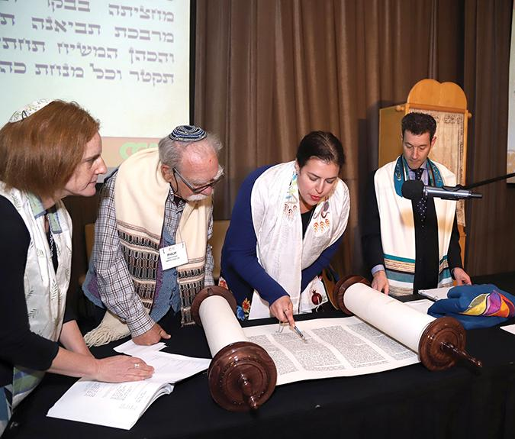
5
It takes a whole year for us to finish reading a Torah scroll. When we finish, we start reading it all over again!
www.jkidaccess.org

Slide 6
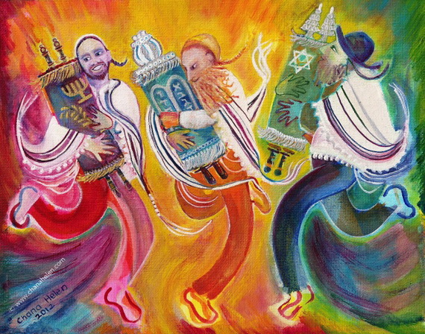
6
To celebrate the end of one year of reading the Torah, we have a big celebration called Simchat Torah!
www.jkidaccess.org

Slide 7
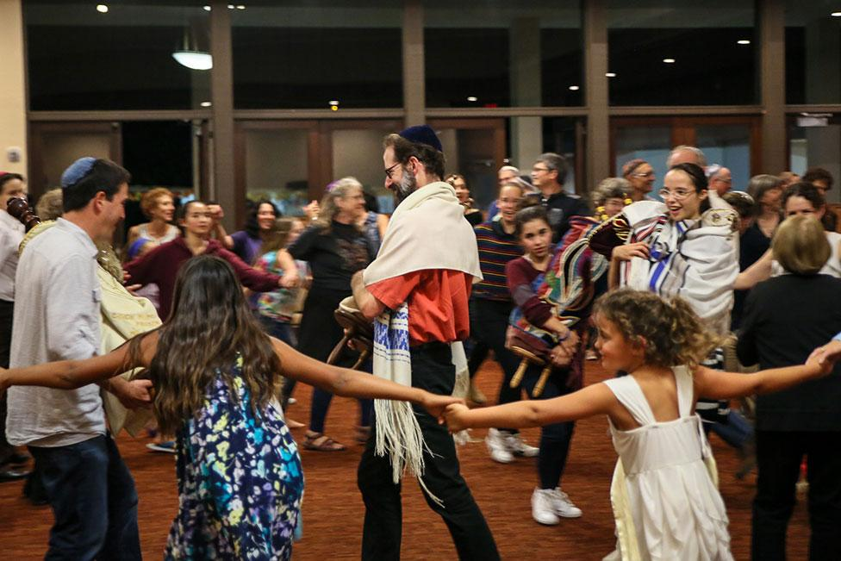
7
In the synagogue, the Rabbi takes the Torah scrolls out of the ark. People hold them and dance with them!
www.jkidaccess.org

Slide 8
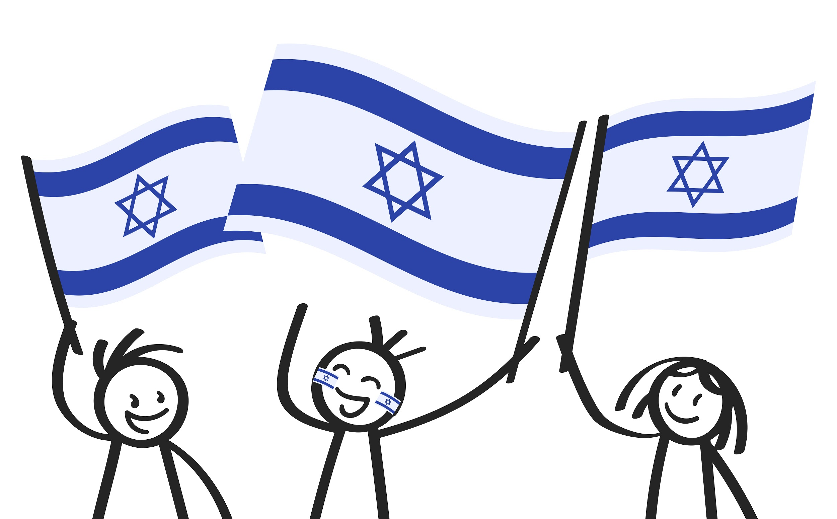
8
Children can march around the synagogue waving colorful flags!
www.jkidaccess.org

Slide 9
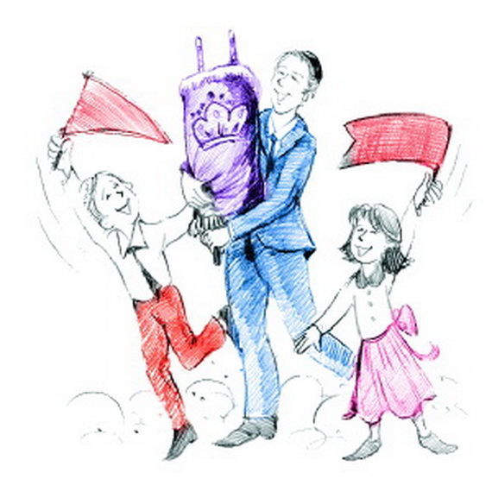
9
Sometimes Simchat Torah can be noisy. It might feel overwhelming to be with lots of people who are singing and dancing.
www.jkidaccess.org

Slide 10
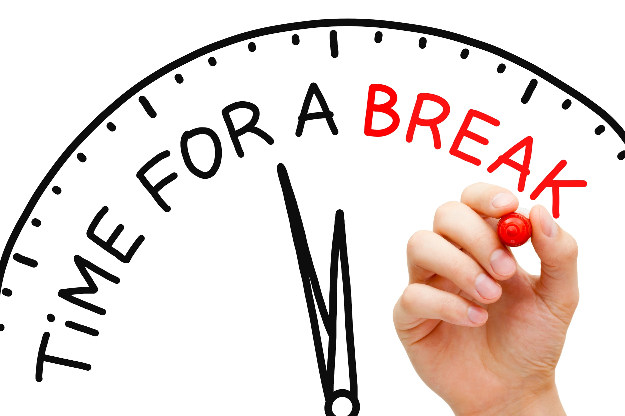
10
If I need a break, I can tell my parents ‘I want to take a break.’
www.jkidaccess.org

Slide 11
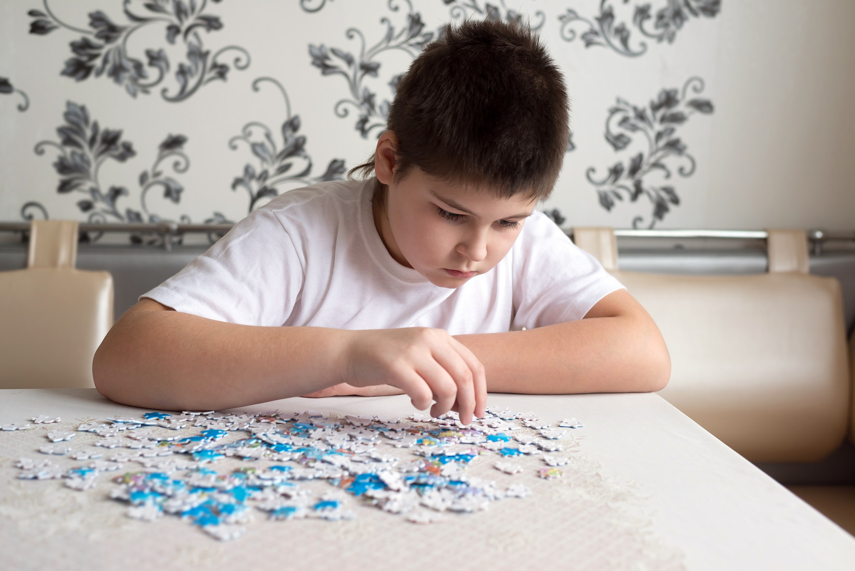
11
I can go to a quiet room away from the singing and dancing until I feel better.
www.jkidaccess.org

Slide 12
12
Sometimes there are yummy snacks at Simchat Torah! There might be candy apples or other sweet treats.
www.jkidaccess.org

Slide 13
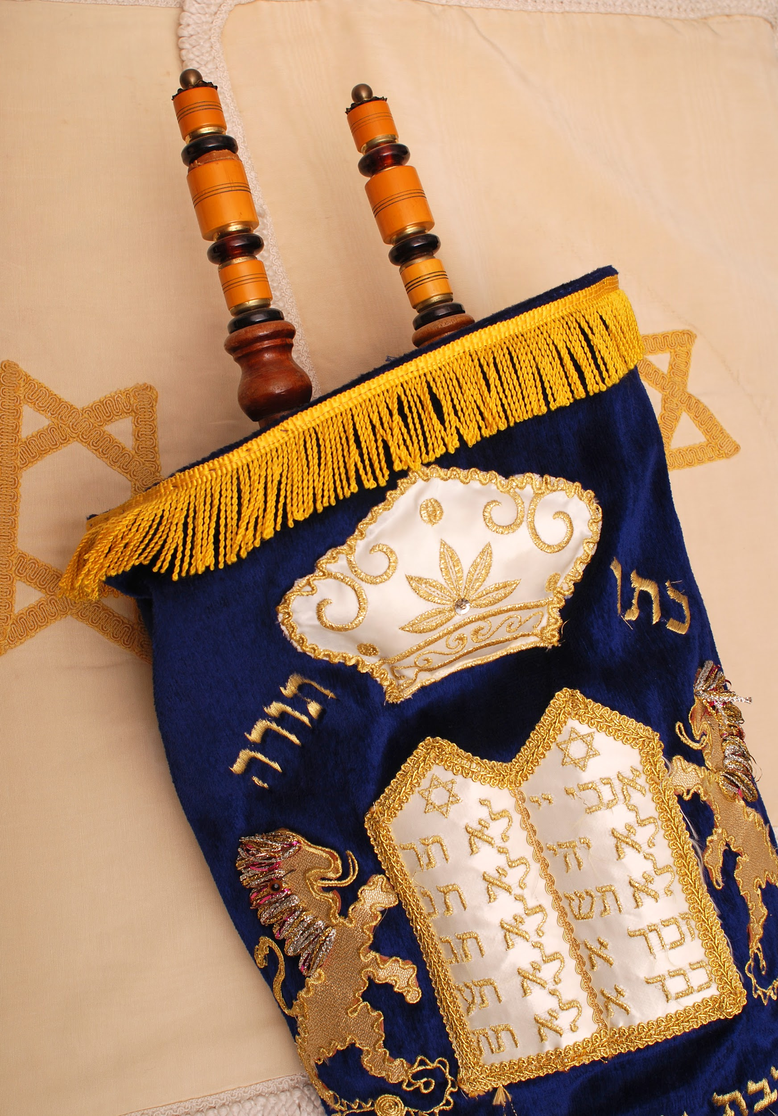
13
Simchat Torah is a fun celebration!
www.jkidaccess.org

