Slide 1
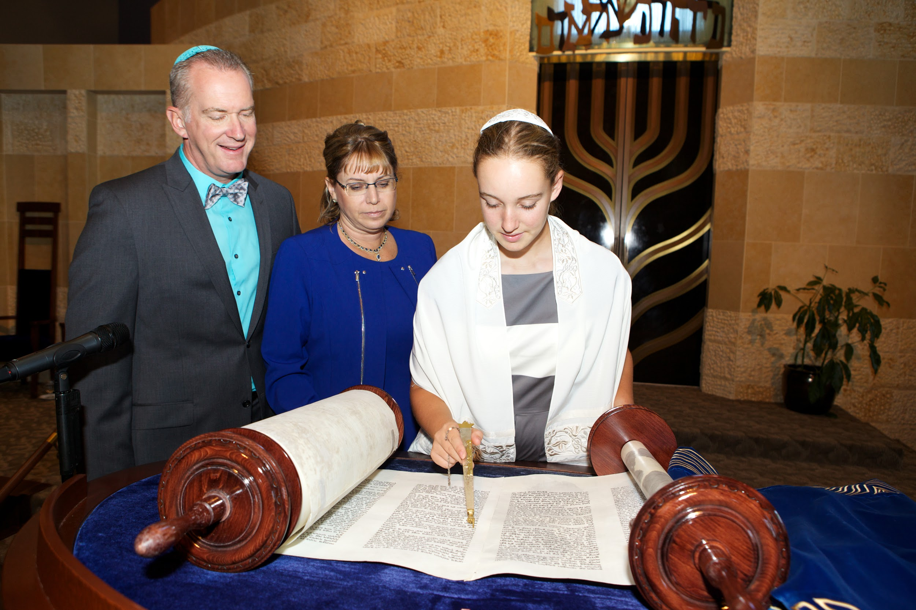
Going to a B’nei Mitzvah
A social story
by
www.jkidaccess.org

Slide 2
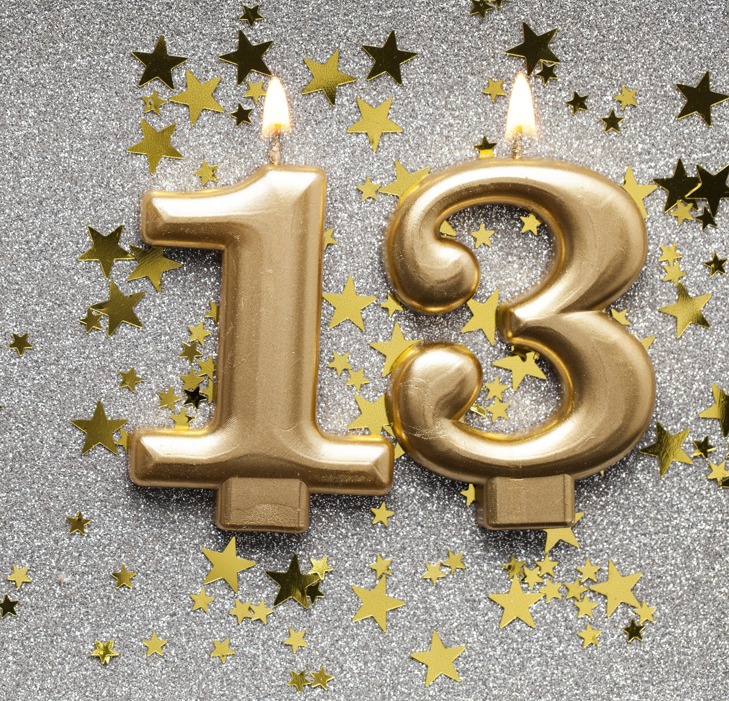
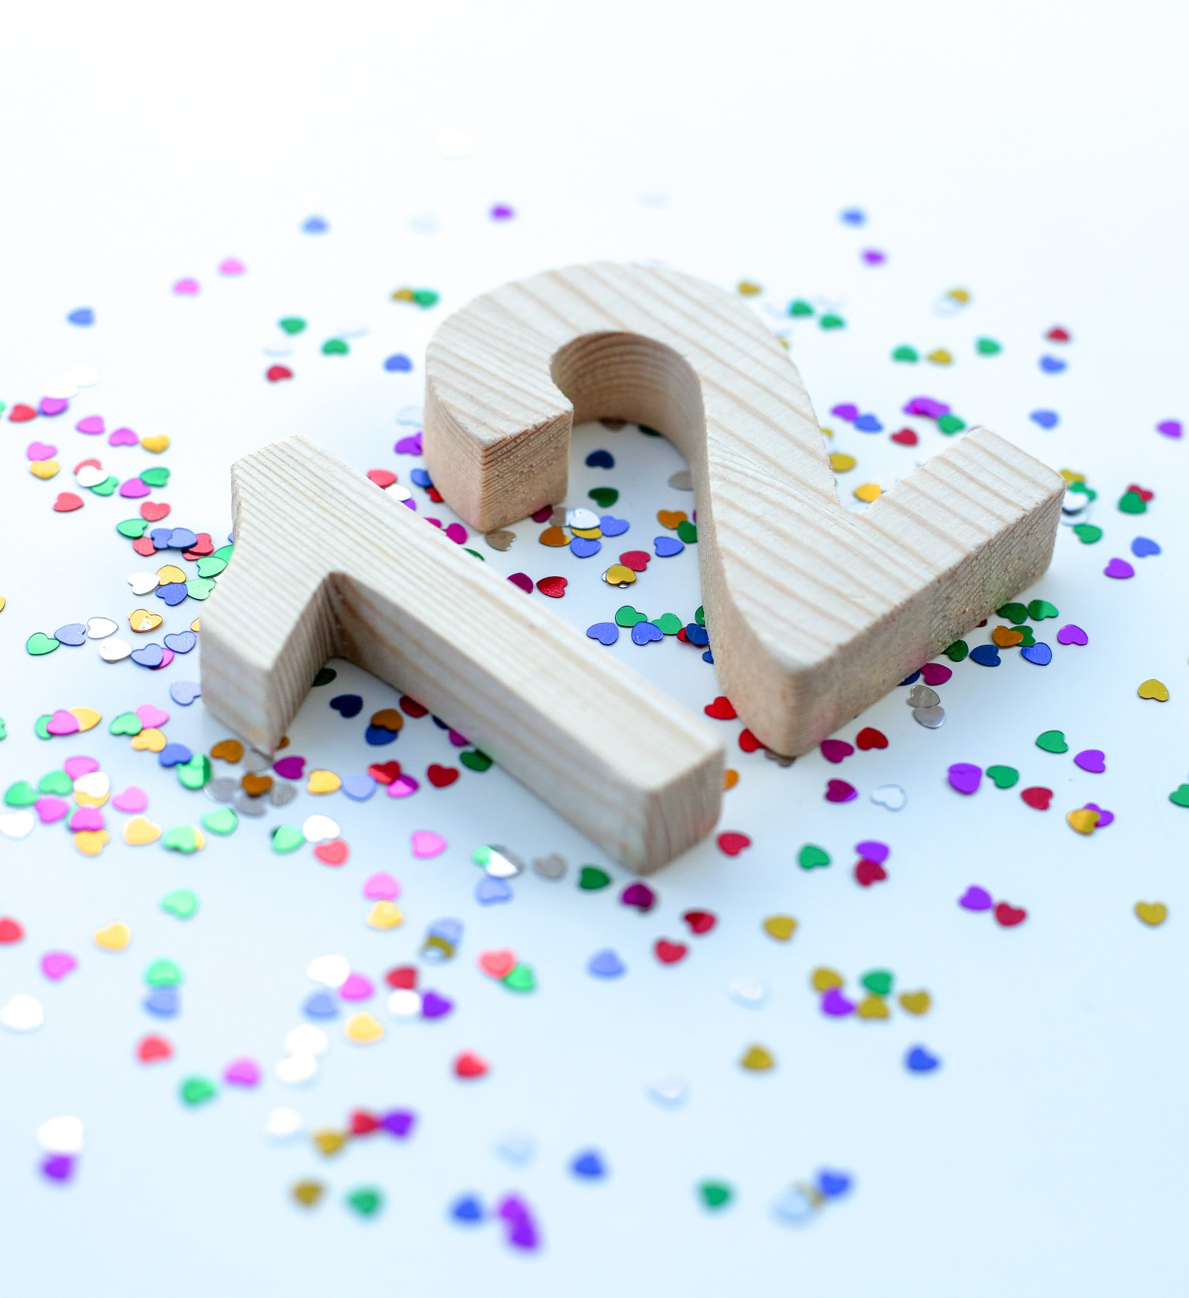
2
Something special happens when a Jewish kid turns
12 or 13.
They become a B’nei Mitzvah!
www.jkidaccess.org

Slide 3
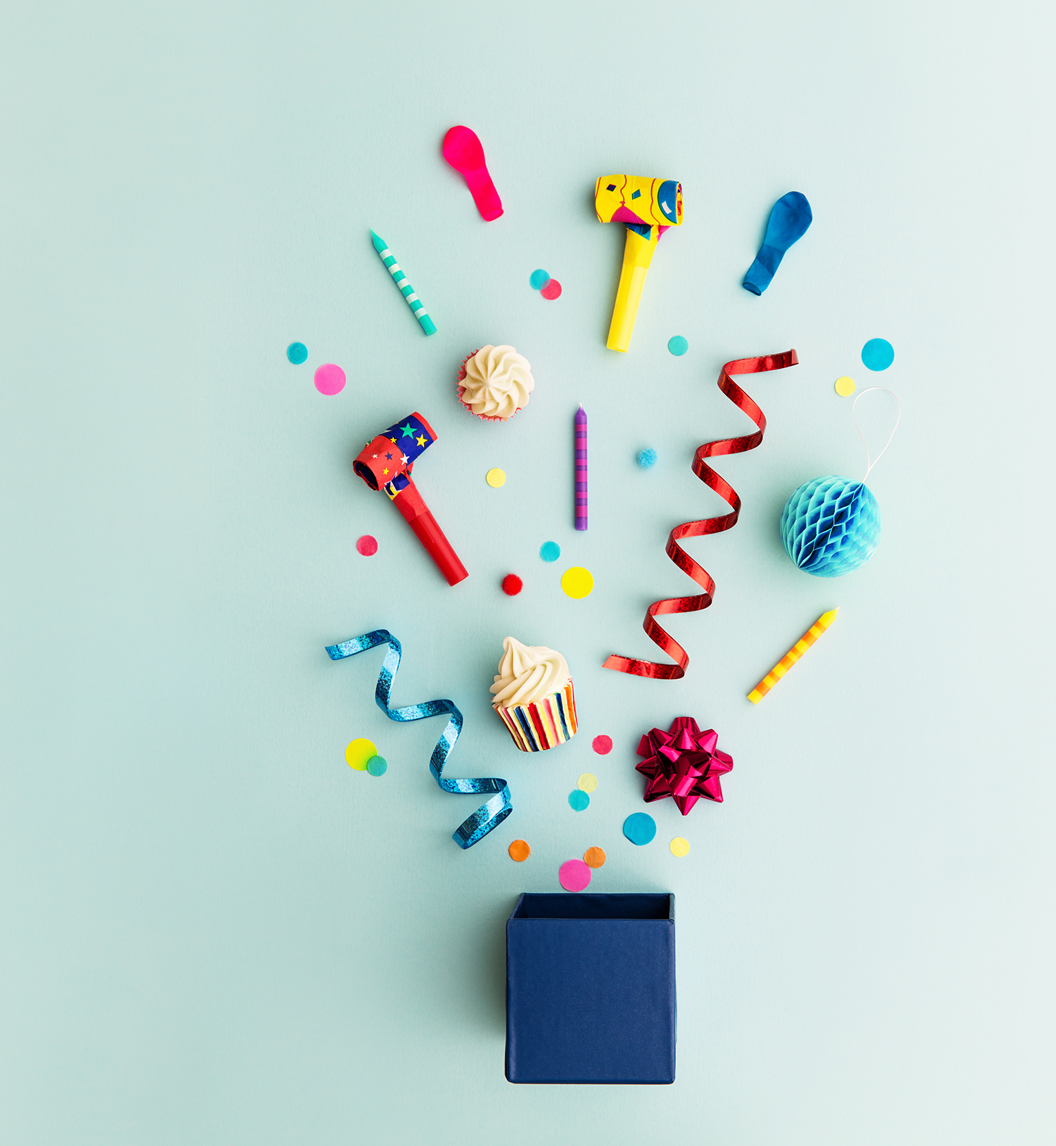
3
When a Jewish child becomes a B’nei Mitzvah, it means that they are fully responsible for themselves and can do more in the Jewish community.
It means that they are growing up and that is something to celebrate.
www.jkidaccess.org

Slide 4
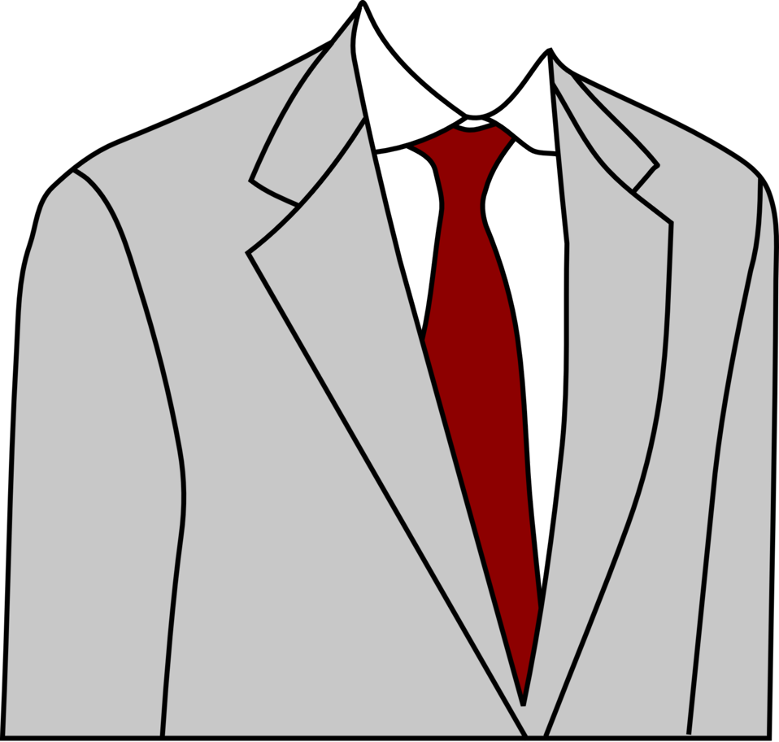
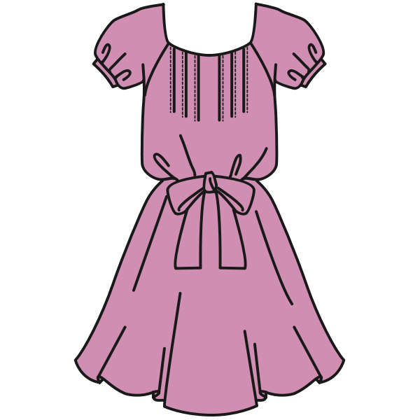
4
Usually, a B’nei Mitzvah starts with a service.
Before we go, we get dressed in our nice clothes. I might wear a shirt and tie or a dress.
www.jkidaccess.org

Slide 5
5
At the service, the B’nei Mitzvah child might sing Hebrew prayers and read from the Torah.
During the service, I can sit in the audience with my family or friends and follow along in my prayer book.
www.jkidaccess.org

Slide 6
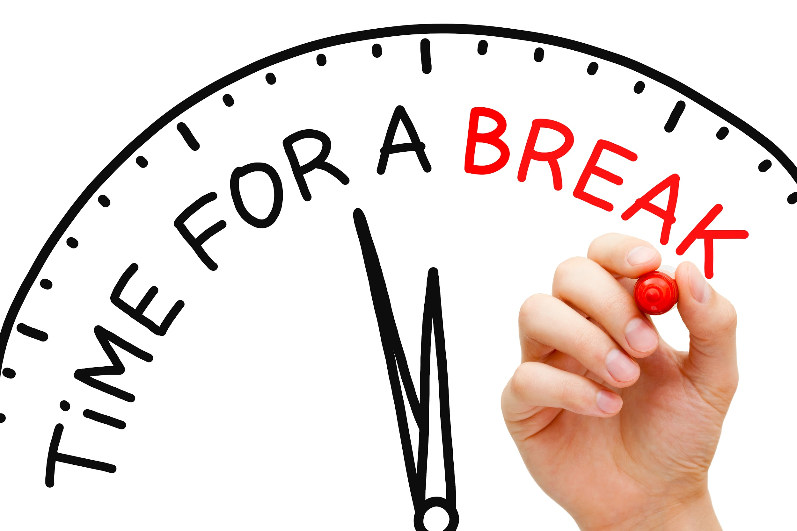
6
If I need to take a break during the service, I can tell my family, “I need to take a break,” and go outside in the hallway for a few minutes.
When I am ready, I can come back into the service.
If it helps me stay calm, I can hold something I like during the service, like a fidget or a weighted lap pad.
www.jkidaccess.org

Slide 7
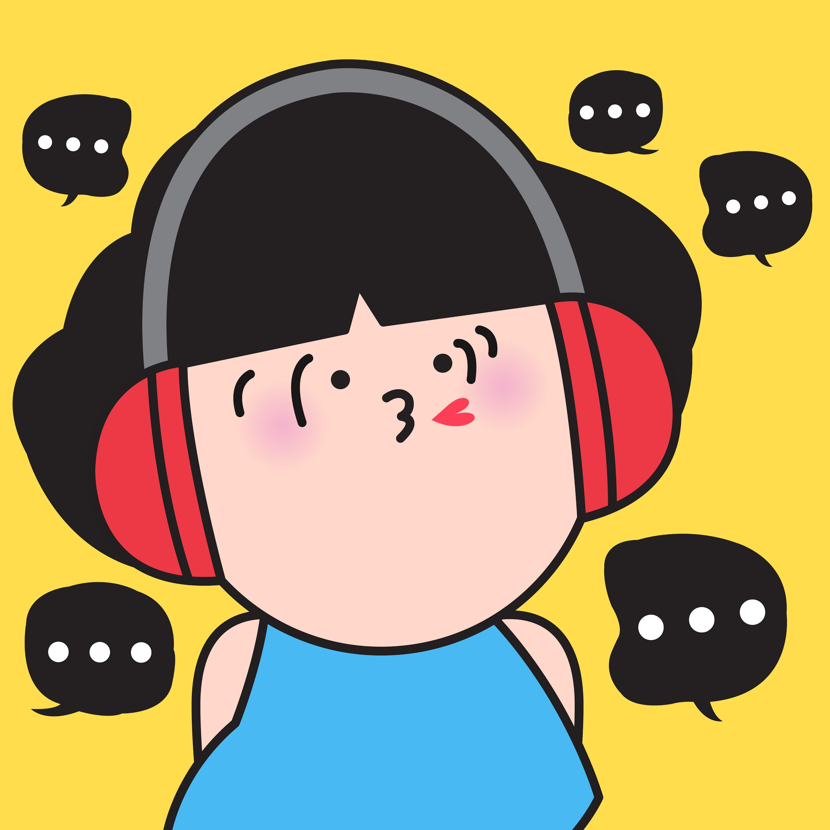
7
After the service, it is usually time for the party!
At the party, there might be dancing and games. Sometimes the music is loud at the party, so I can bring noise-canceling headphones or earplugs if that helps me stay calm.
www.jkidaccess.org

Slide 8
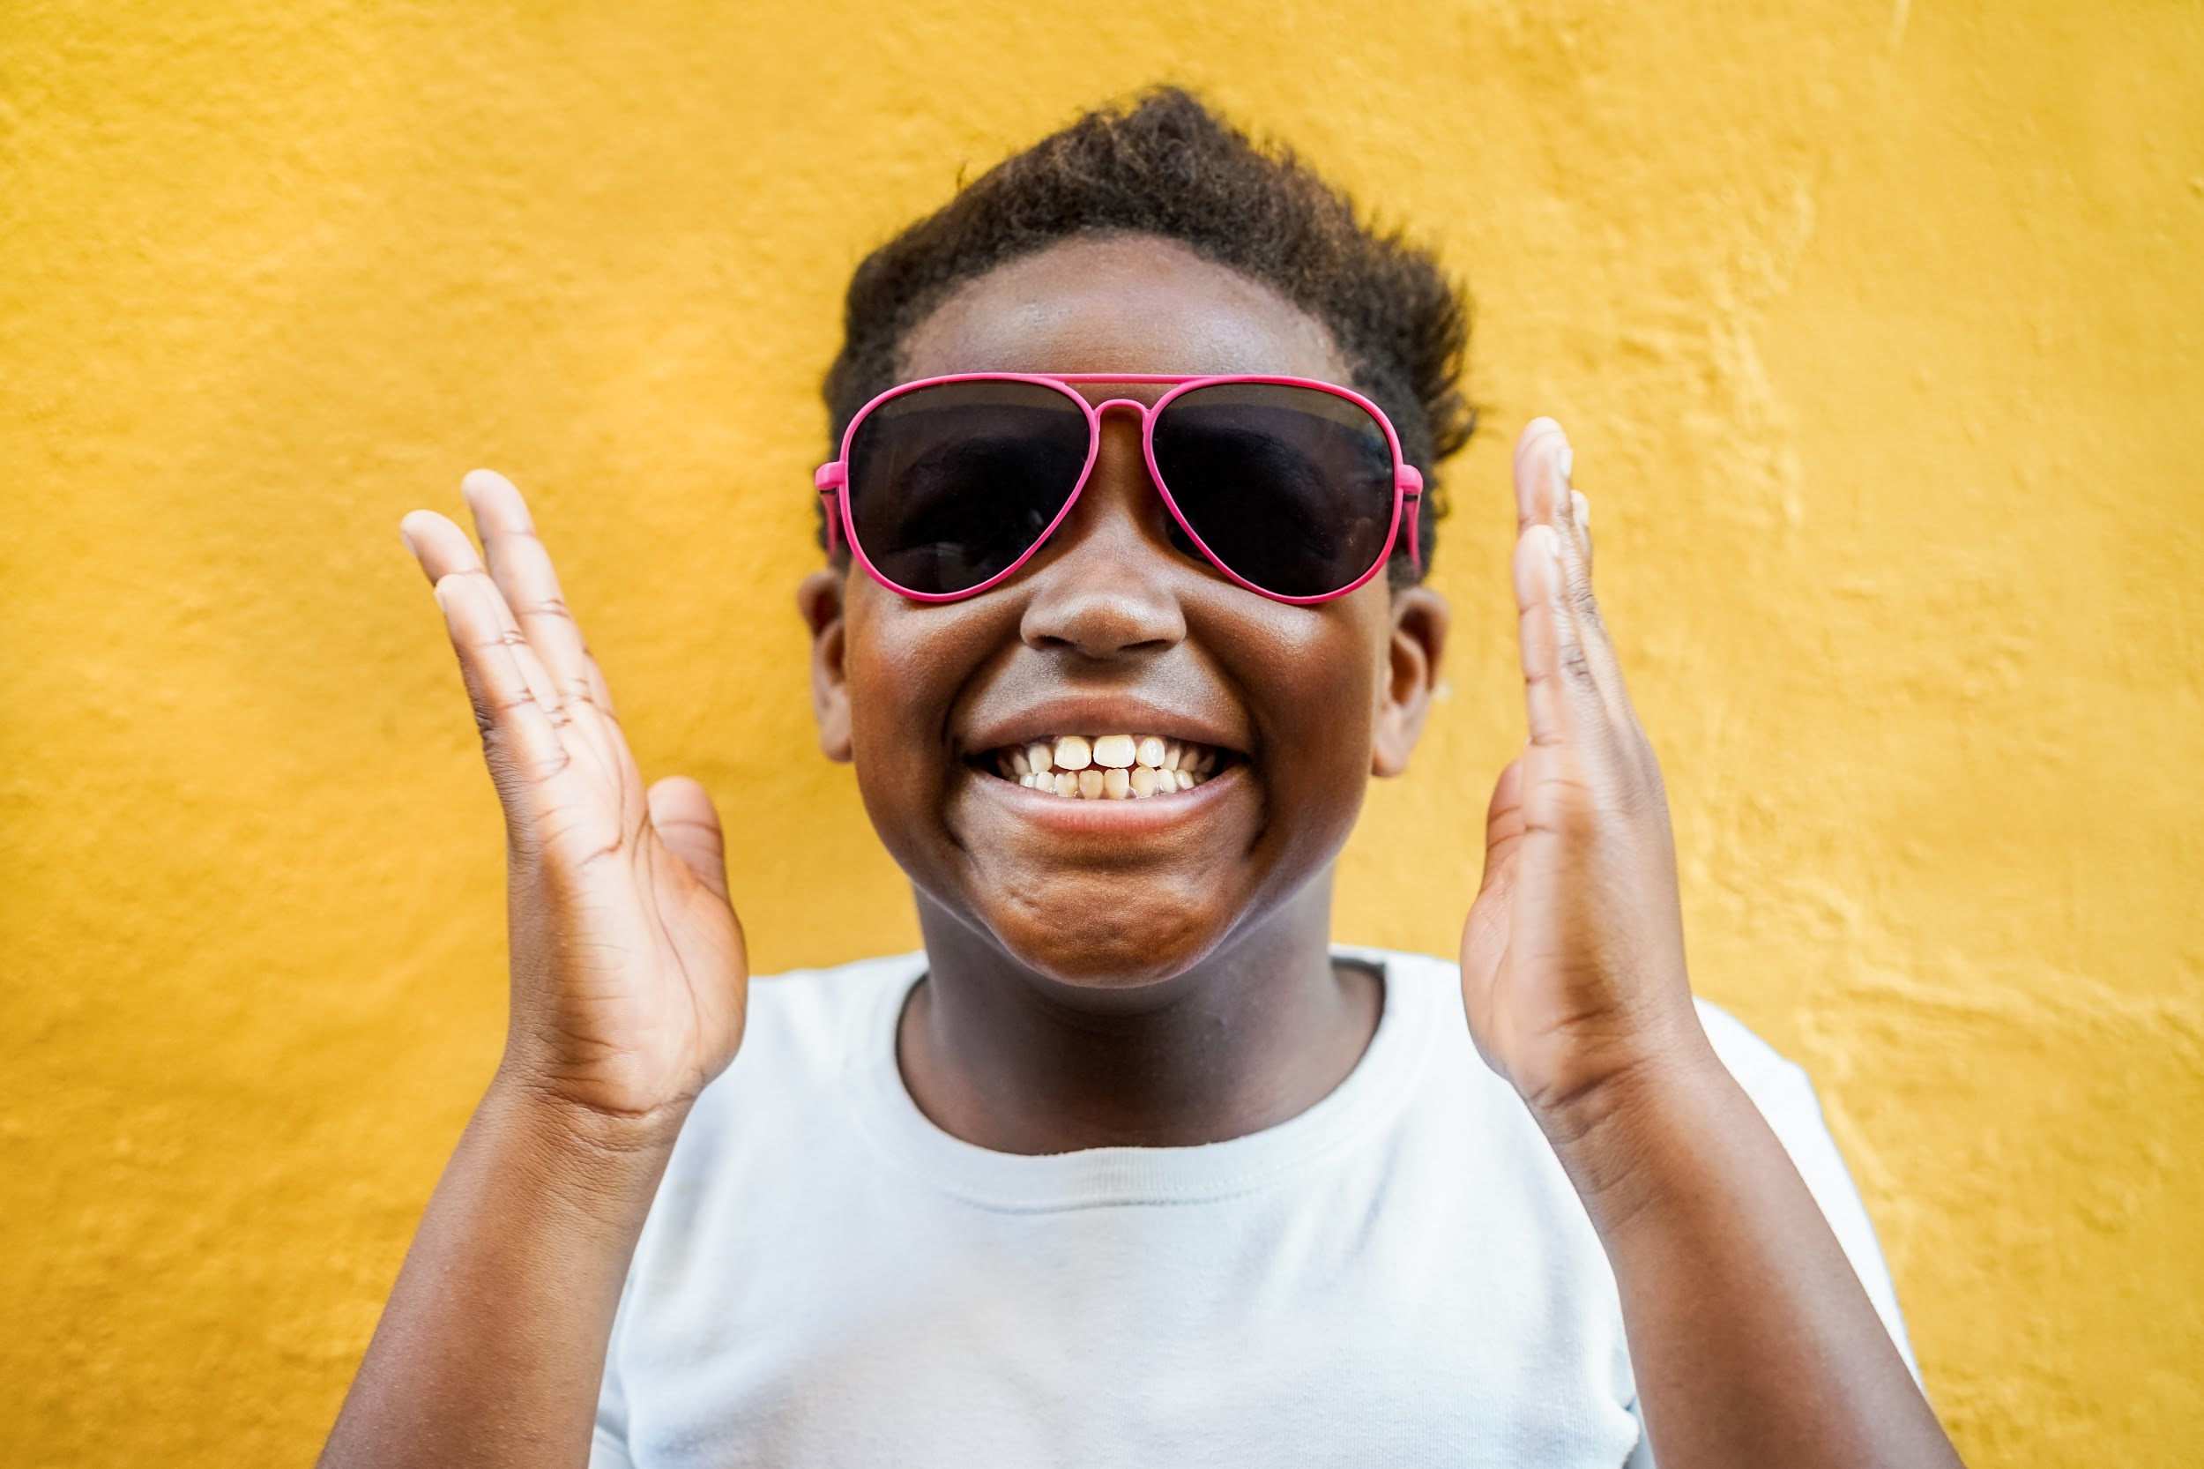
8
Sometimes at the party, the room could be dark and there might be bright, flashing lights to make it feel like a fun party. It might help me to wear sunglasses if the lights hurt my eyes.
www.jkidaccess.org

Slide 9
9
If I need to take a break from the lights and the party, I can say, “I need to take a break,” and then go out into the hallway until I’m ready to come back in.
www.jkidaccess.org

Slide 10
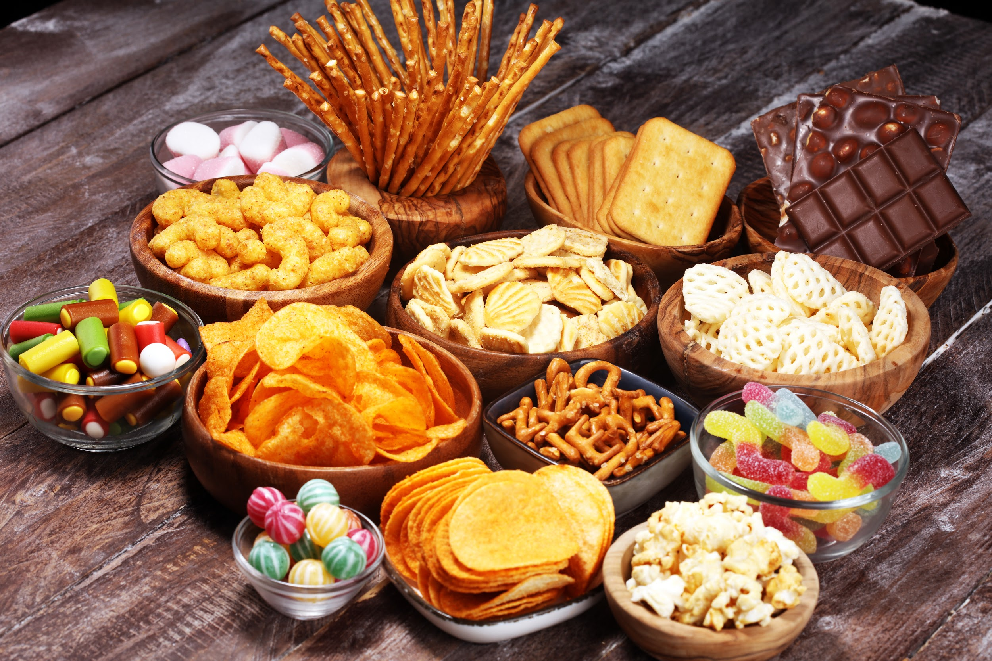
10
There might be lots of yummy food and snacks to eat at a B’nei Mitzvah party.
If I have allergies, I’ll make sure to ask my family what I can eat so that I can stay safe and healthy.
www.jkidaccess.org

Slide 11
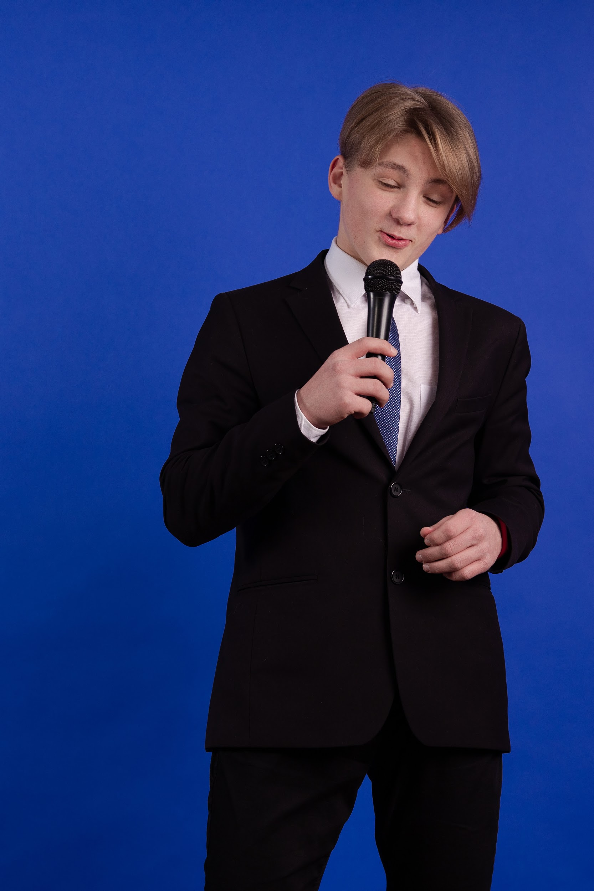
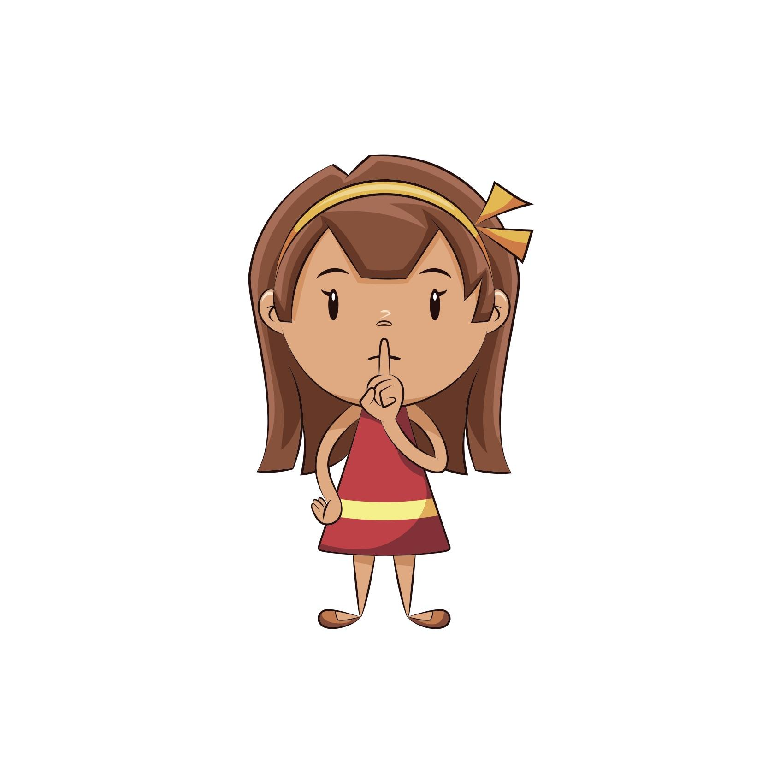
11
During the party, some people might give short speeches to say thank you or to celebrate the B’nei Mitzvah kid.
This is a time when everyone else at the party is quiet so they can listen to the speech.
www.jkidaccess.org

Slide 12
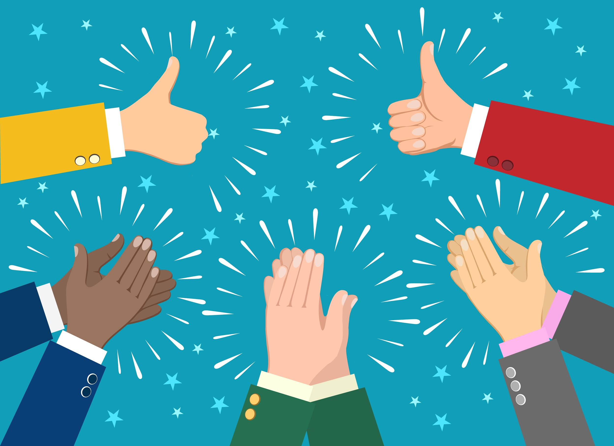
12
B’nei Mitzvah celebrations can be really special and fun. The B’nei Mitzvah kid worked very hard all year to learn their Torah portion and all of the prayers.
I can say something nice to them like, “you did a great job!” or “I am proud of you!”
www.jkidaccess.org

