Slide 1
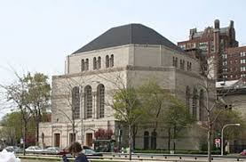
Going to Synagogue for Shabbat
A social story
by
www.jkidaccess.org

Slide 2
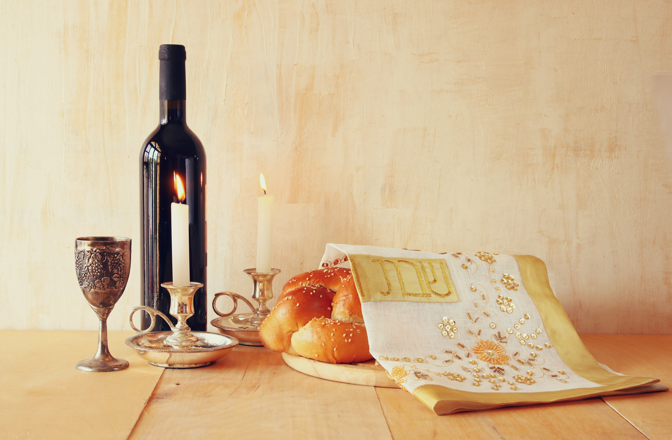
2
Shabbat comes every week--from Friday at sundown to Saturday at sundown.
www.jkidaccess.org

Slide 3
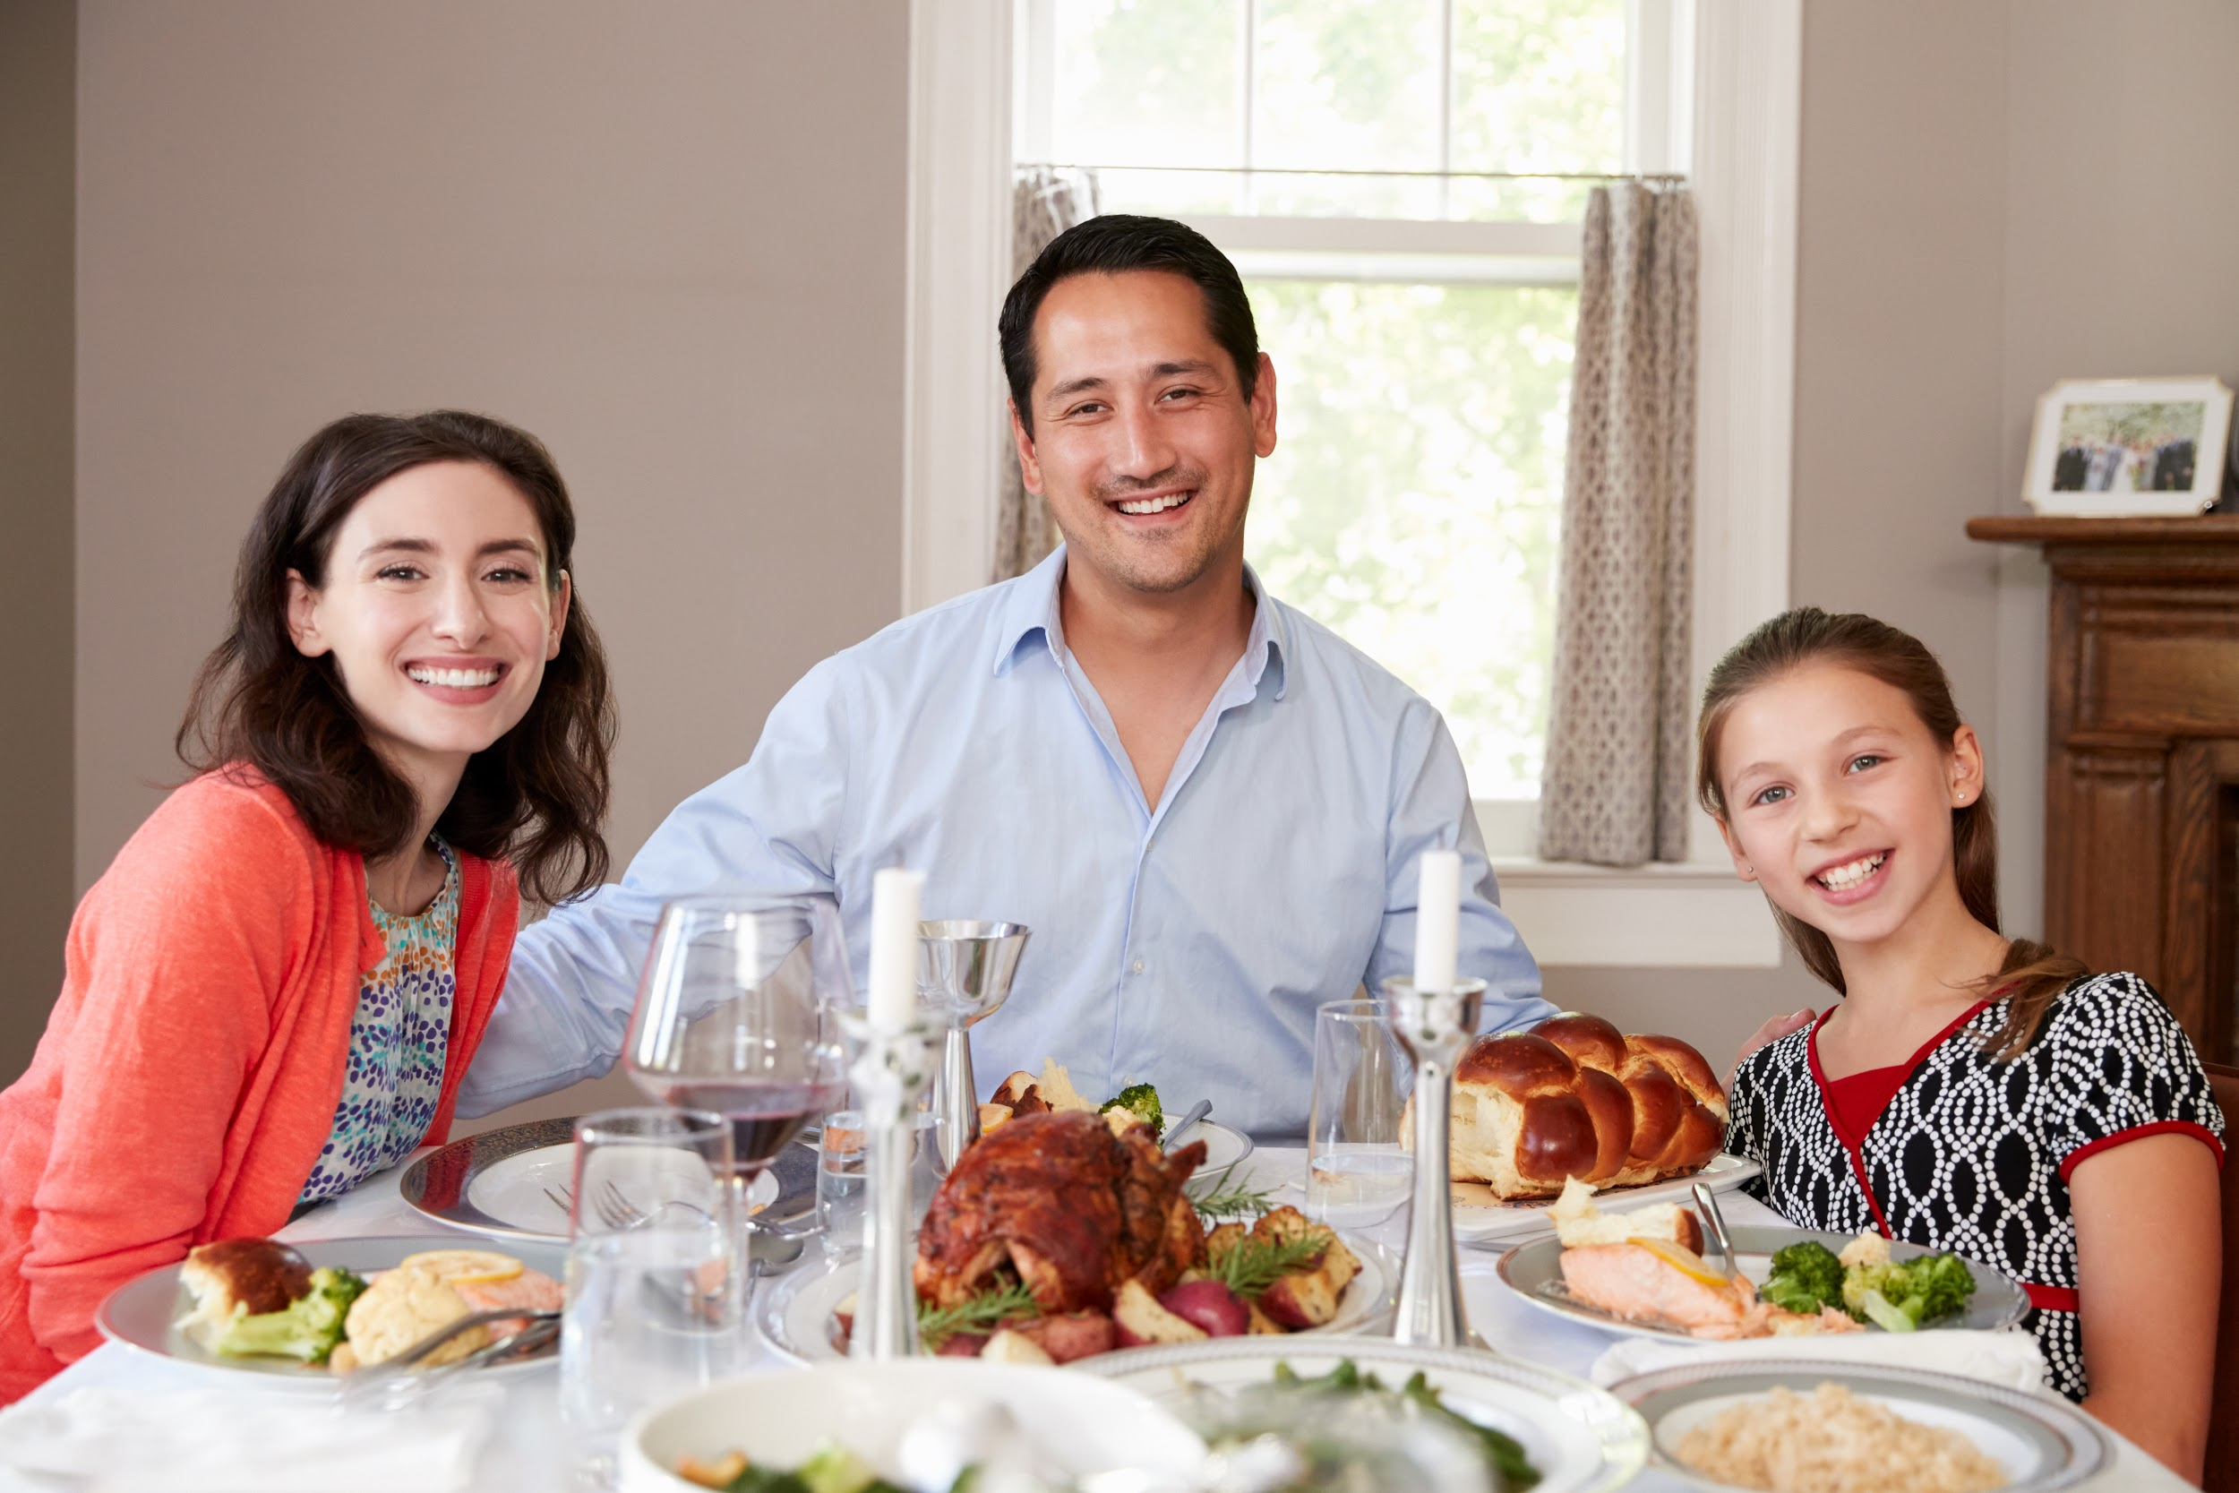
3
For Jewish people, Shabbat is a special day. On Friday nights, many people light candles, drink grape juice or wine, eat challah and have a yummy dinner.
www.jkidaccess.org

Slide 4
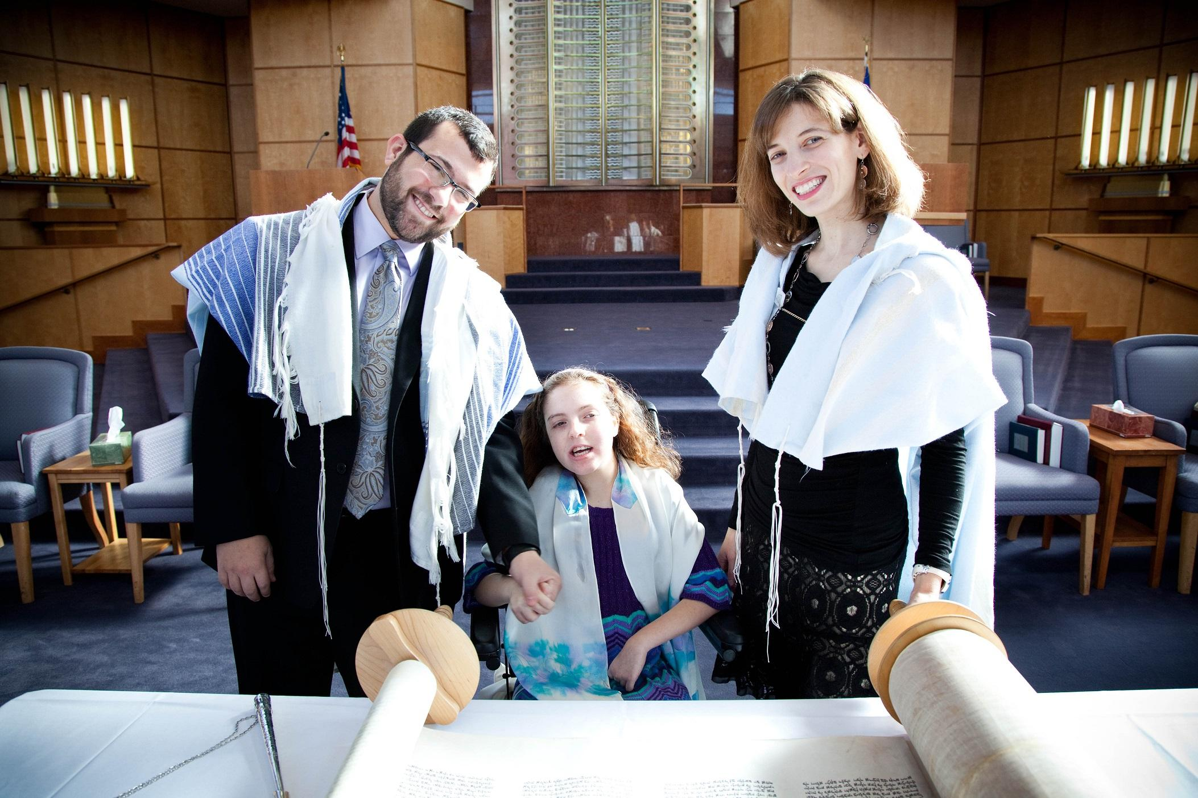
4
Some families also go to a synagogue on Friday night or Saturday morning.
www.jkidaccess.org

Slide 5
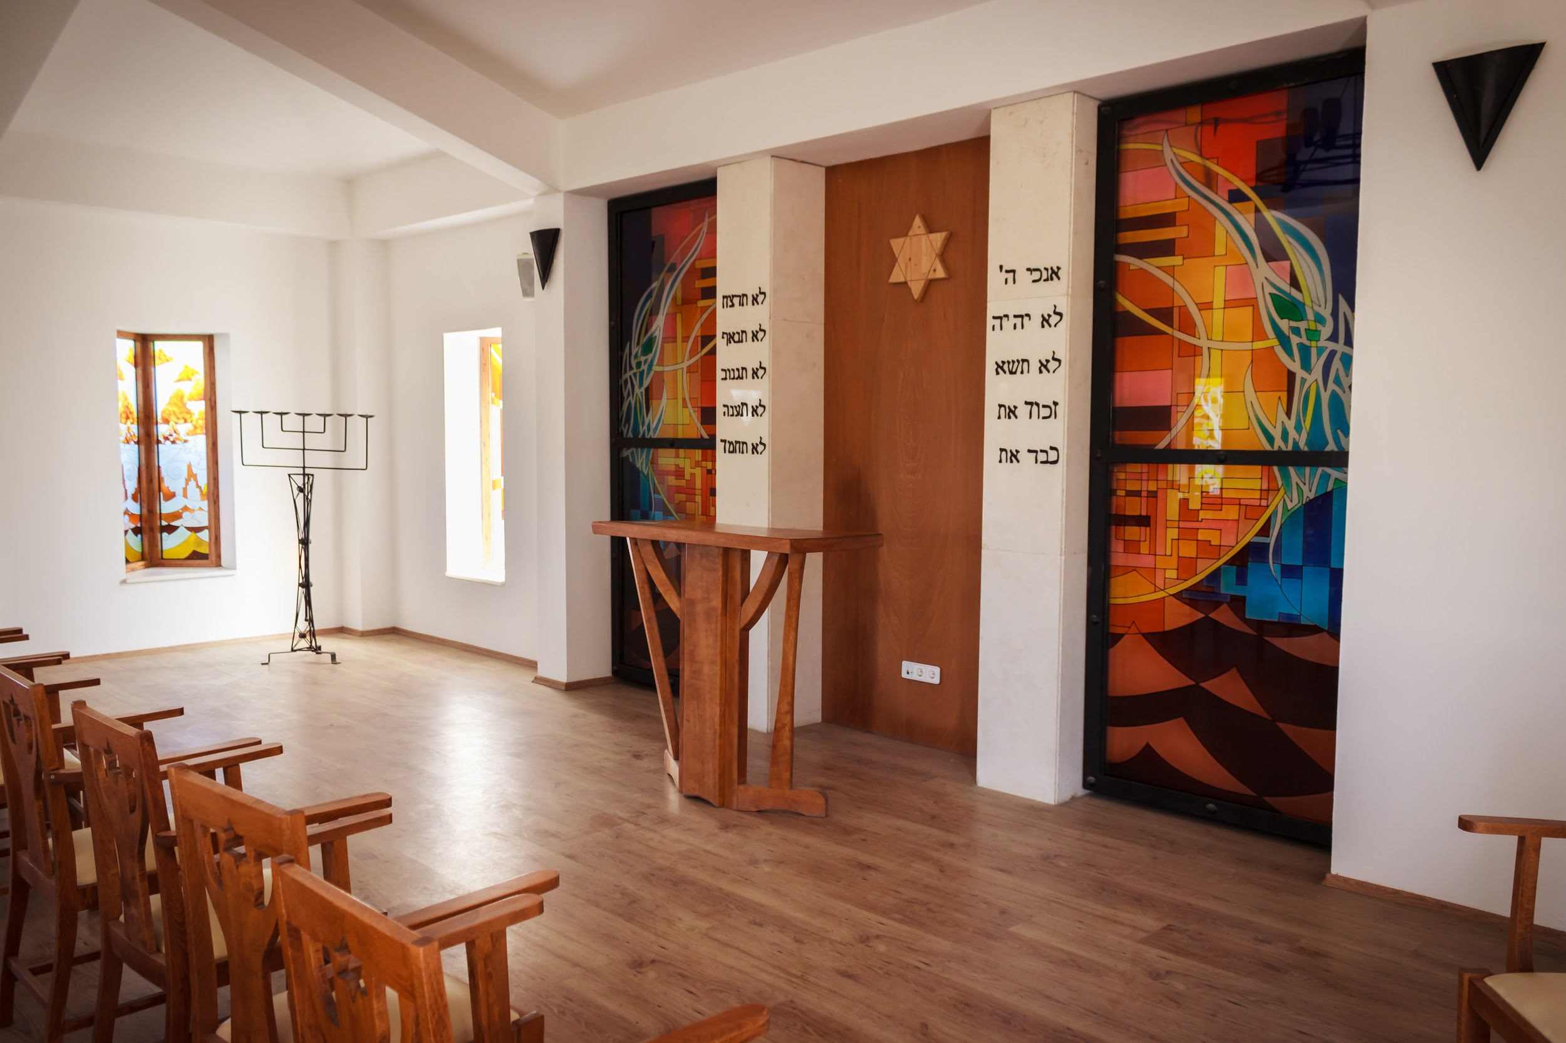
5
At synagogue, we go to services in a beautiful sanctuary.
www.jkidaccess.org

Slide 6
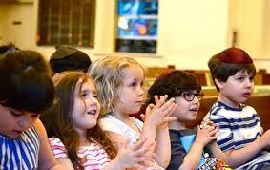
6
During services, we say prayers and sing songs.
www.jkidaccess.org

Slide 7
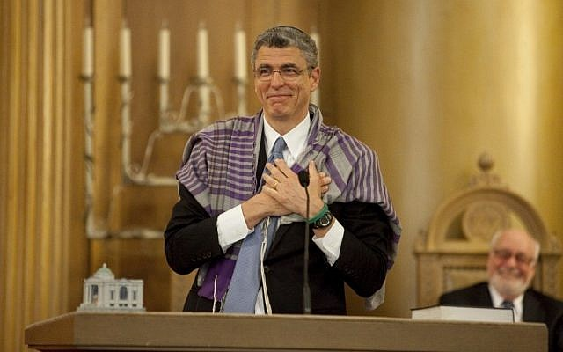
7
The services are usually led by a rabbi or a cantor. Sometimes other adults, teens and children help to lead the service.
www.jkidaccess.org

Slide 8
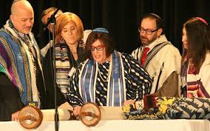
8
At some services, we read from the Torah. The Torah is a special kind of scroll with Hebrew letters on it. The Torah tells us important Jewish stories.
www.jkidaccess.org

Slide 9
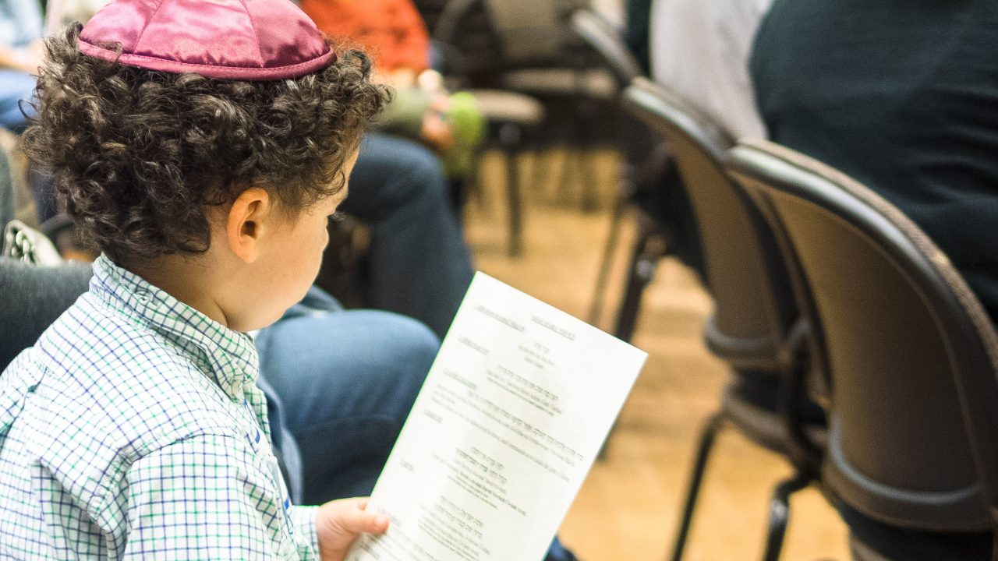
9
A synagogue is a place where I am safe to be myself.
www.jkidaccess.org

Slide 10
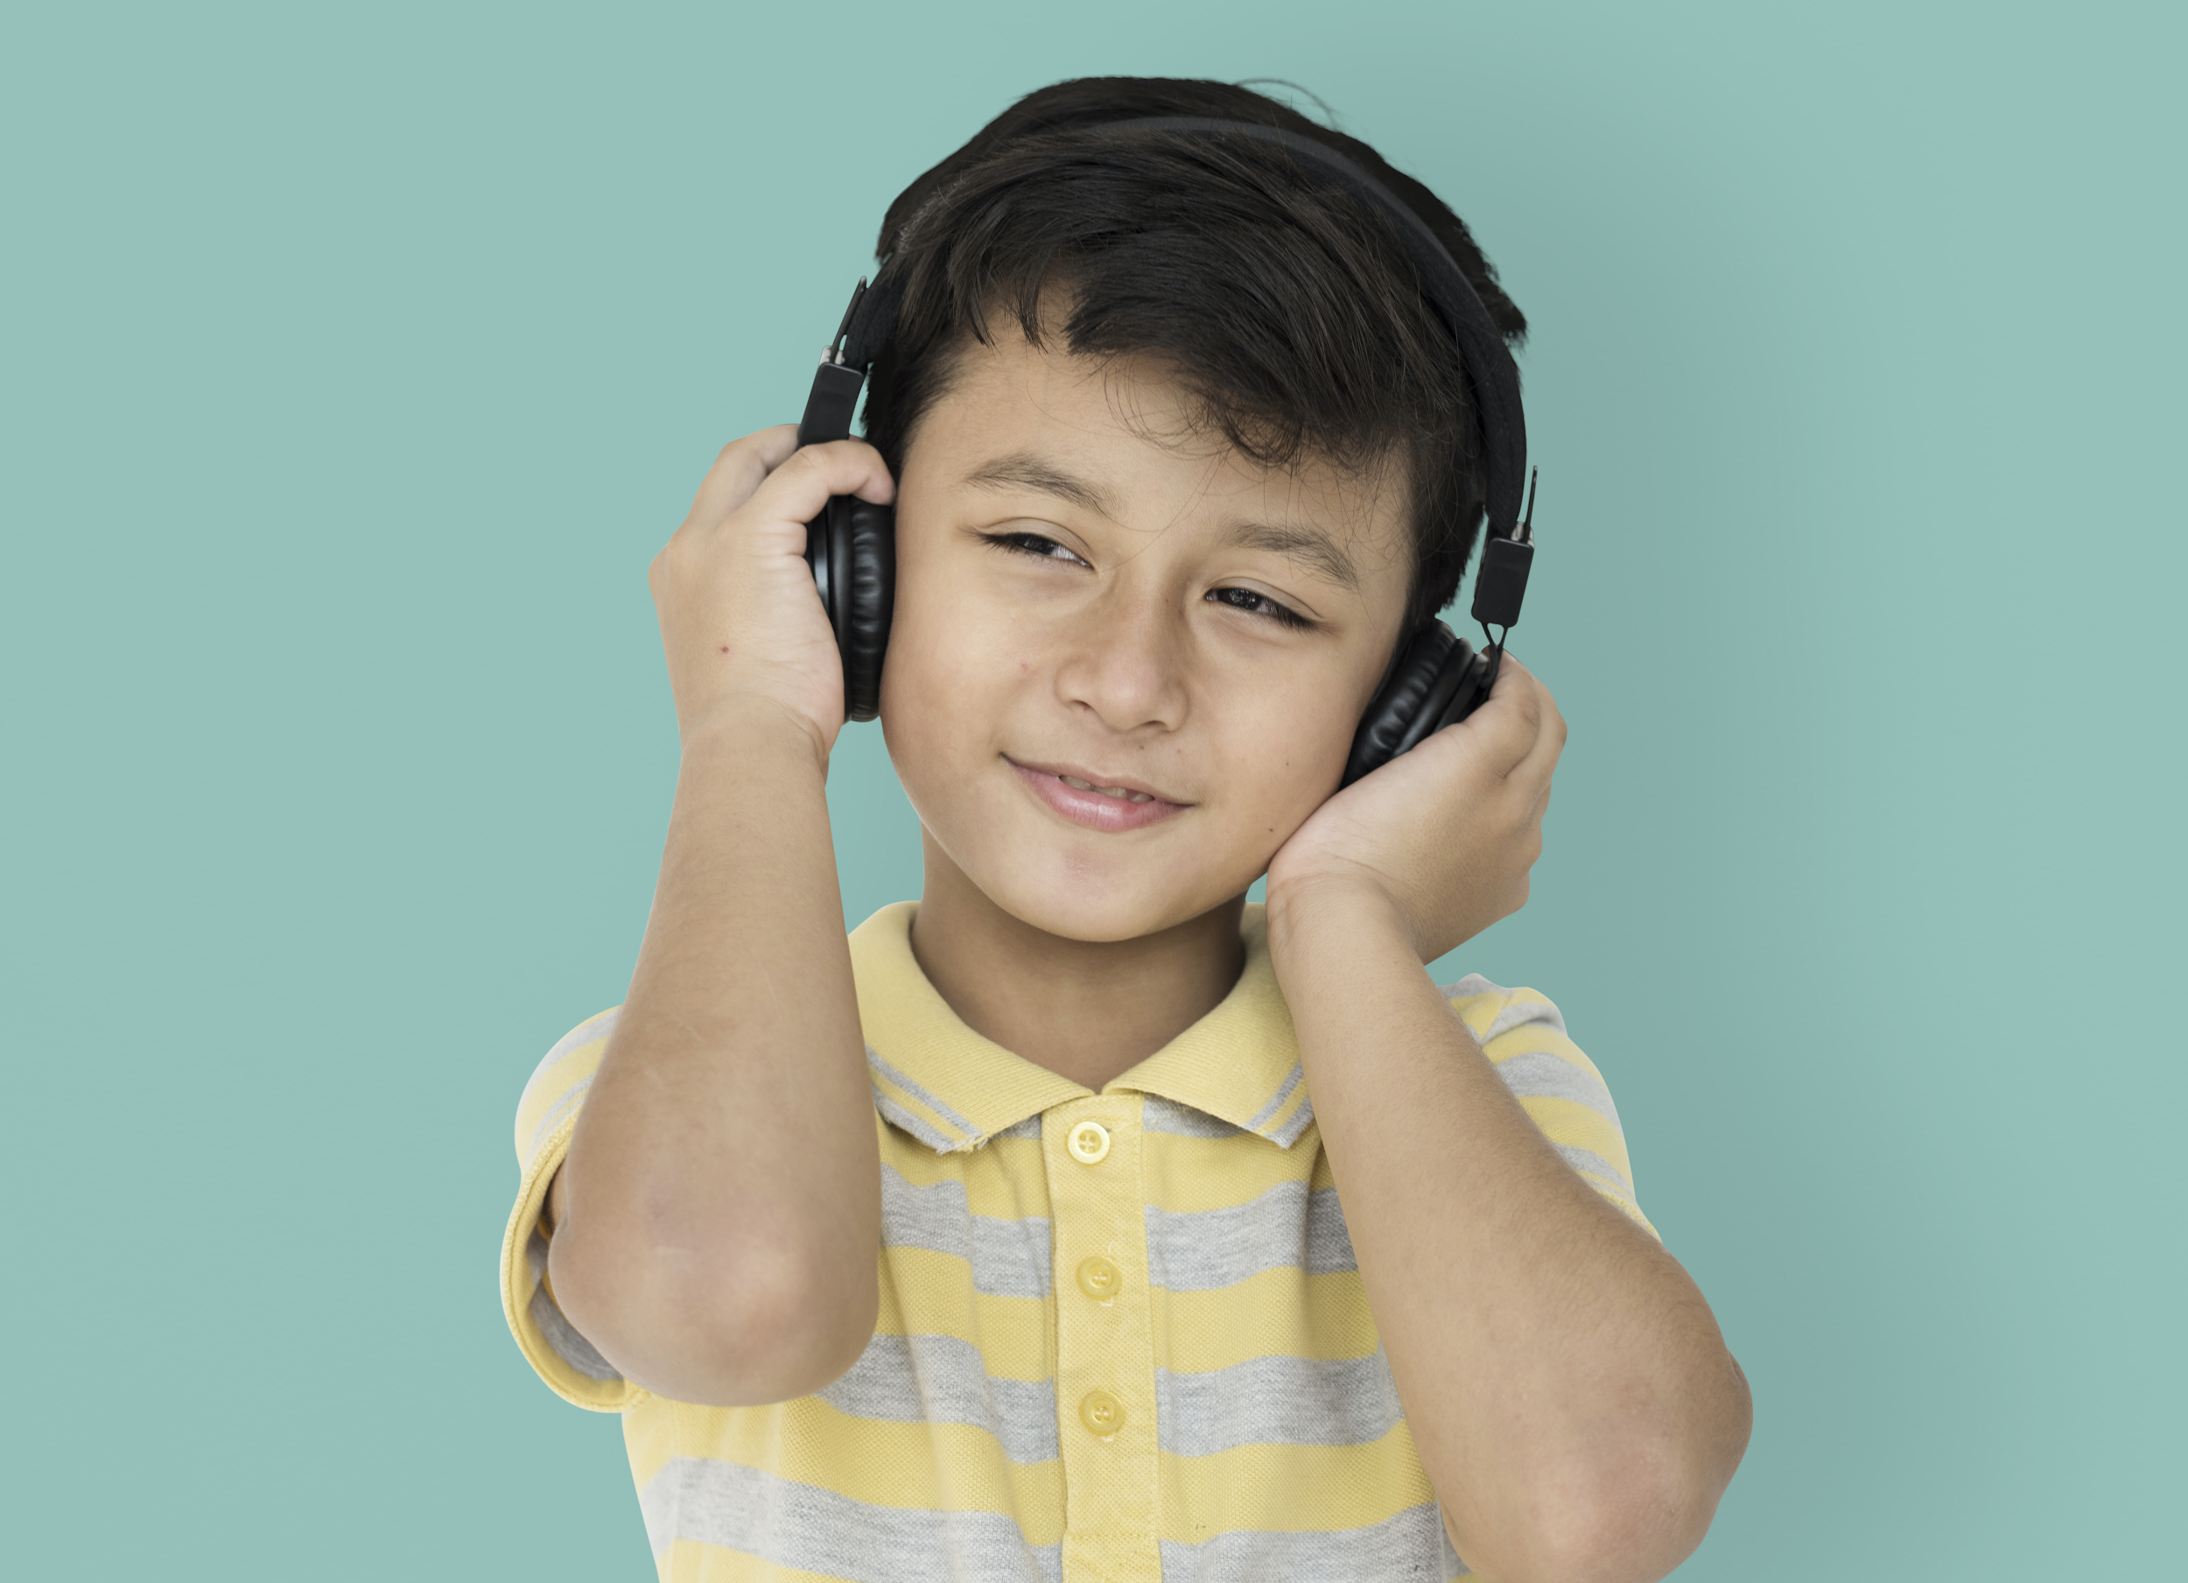
10
If the music is too loud, I can wear noise-cancelling headphones.
www.jkidaccess.org

Slide 11
11
If the service is too long and it’s hard to sit still, I can tell my parents that I need a break.
www.jkidaccess.org

Slide 12
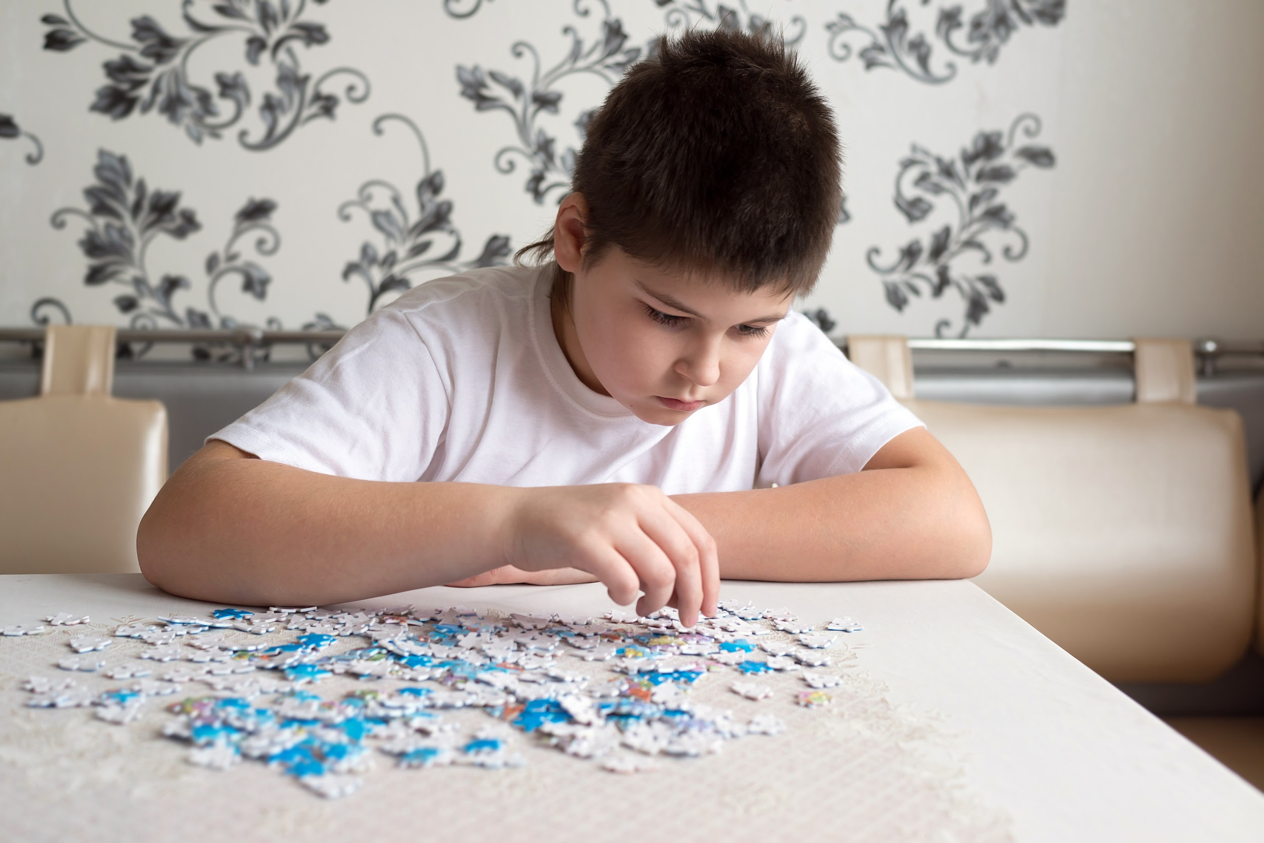
12
I can also bring books or quiet toys like a puzzle to play at synagogue. Some synagogues have a quiet room where kids can play.
www.jkidaccess.org

Slide 13
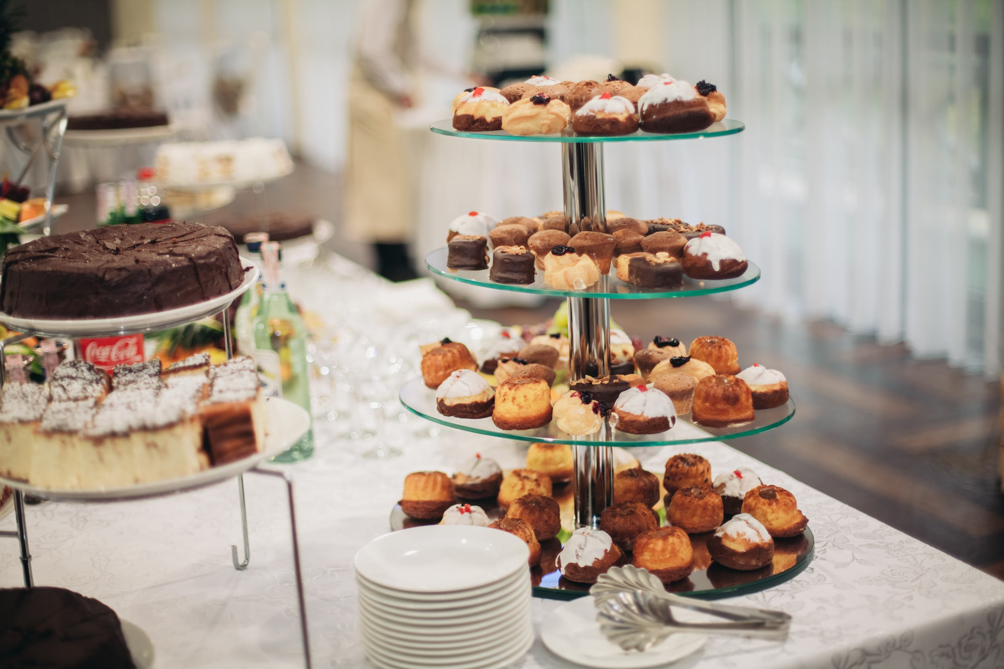
13
After services, there is time to get a yummy treat to eat!
www.jkidaccess.org

Slide 14
14
There are lots of people at synagogue who are happy to see me! They may smile at me and say
“Shabbat Shalom!”
I can say “Shabbat Shalom” back
to them.
www.jkidaccess.org

Slide 15
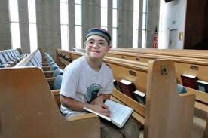
15
I like going to Shabbat services at my synagogue!
www.jkidaccess.org

